Slide 1
OpenPET software GUI design schemes
Qiyu Peng

Slide 2
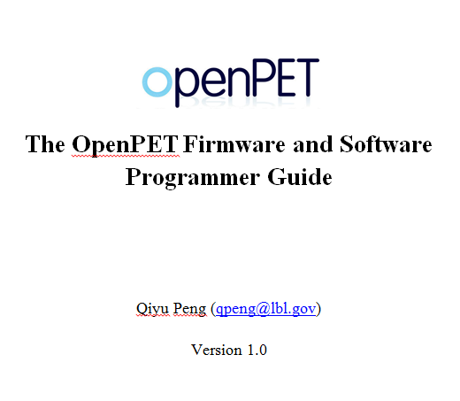

Slide 3
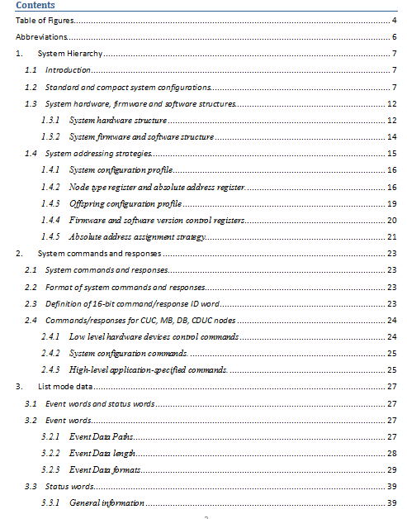

Slide 4
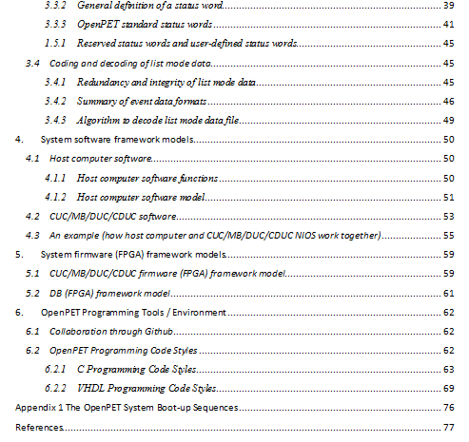

Slide 5
Programming Tools / Environment
 | DB | DUC | MB | CUC | Host PC
FPGA Firmware | X | X | X | X
Embedded MCU Software (NIOS) |  | X | X | X
PC Software |  |  |  |  | X
X: VHDL (Altera Quartus II ver. 12.0)
X: C (Altera Nios II EDS ver. 12.0)
X: C (NI LabWindows CVI 2009)

Slide 6
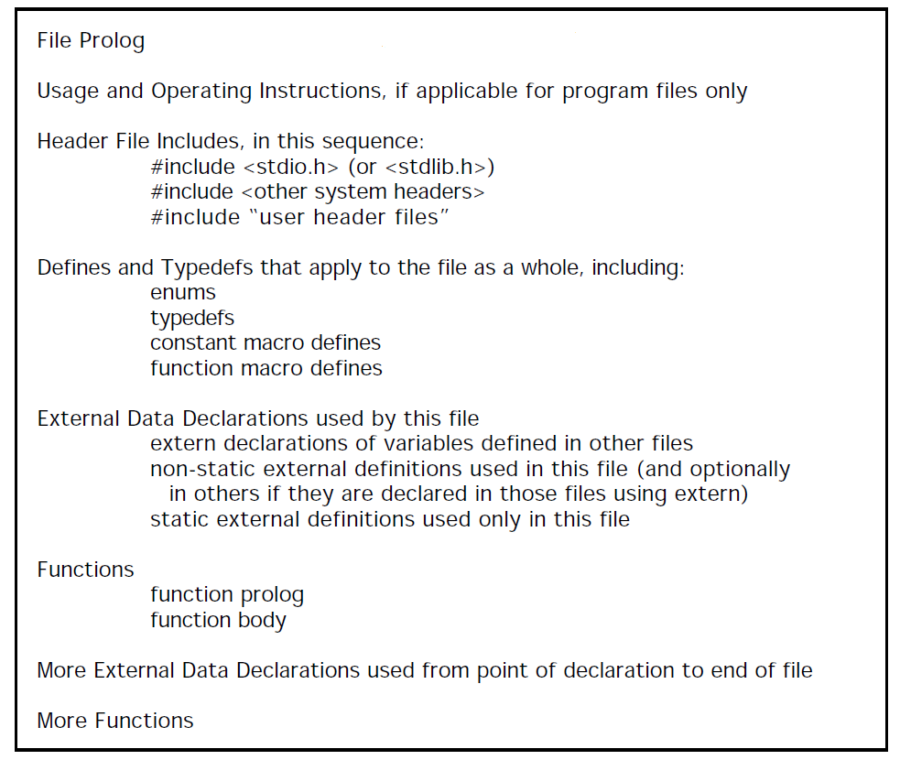
C programing style guidelines
Rules and guidelines are used to guarantee the readability and maintainability of the C source codes (details are in my word file)
Based on “C Style Guide” suggested by Software Engineering Laboratory (SEL), the National Aeronautics and Space Administration (NASA) in 1994.

Slide 7
Host PC software
Modular Design
Simple and easy to use
Upgradable
Main Functions
System configuration and system diagnosis
Data acquisition
Data analysis

Slide 8
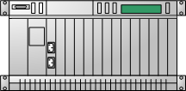

Software Requirement Analysis
System calibration and characterization
(control console and scripts)
Acceptable range definition ?
System configuration and test
(GUI and scripts)
DAQ configuration and DAQ
(GUI and scripts)
Data analysis and visualization
(GUI and scripts)
System configuration files
List mode data (with a head file)
List mode data (with a head file)
Data analysis reports
System HW/FW
System HW/FW

Slide 9
Data and Configurations Files
System configuration database
List mode data file
List mode data head file
Data analysis report file
Acceptable range definition file?

Slide 10
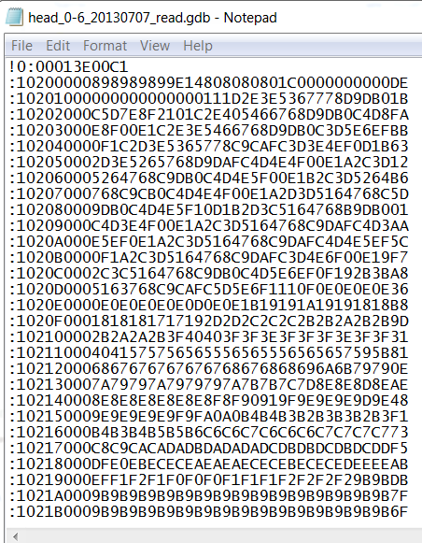
System configuration files (Siemens)
Siemens database file

Slide 11
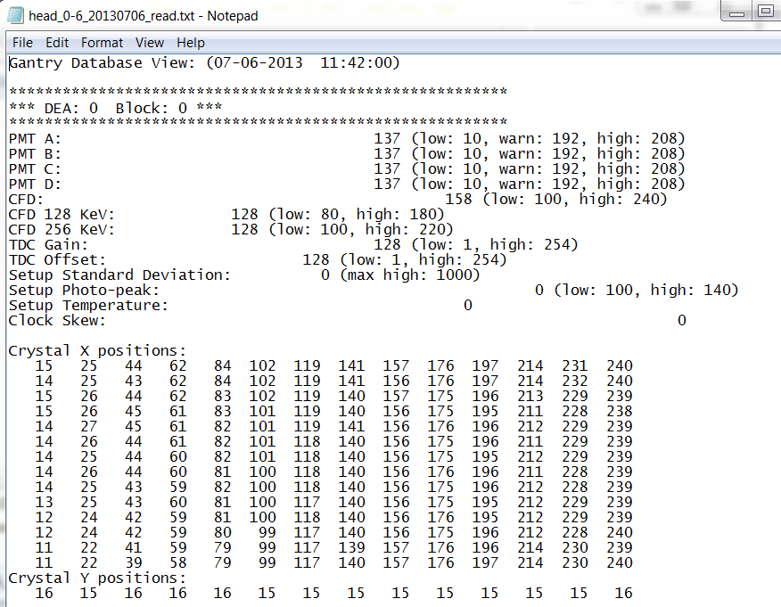
System configuration files (Davis)
Siemens database converted to text format

Slide 12
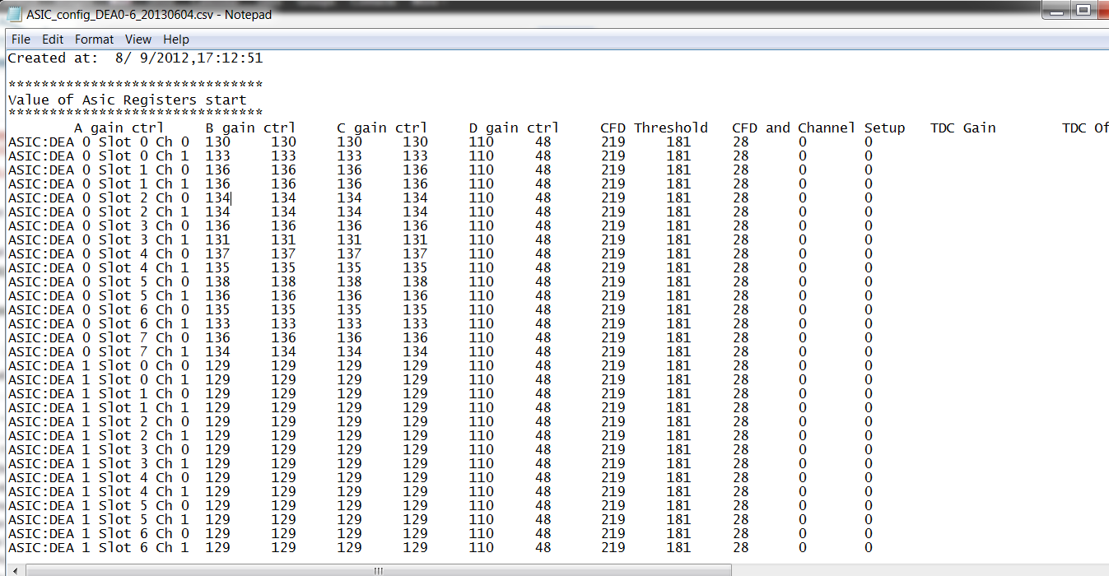
System configuration files (LBNL)
TOFPET database (text format)

Slide 13
Siemens system configurations
Host PC
Non-volatile memories
Volatile memories
Coincidence controller
OS
Applications
FPGA codes
Registers
PC-104
(hard disk, file system)
FPGA
EPCS
DEA0~11
BLK_CON
AS_RUN
…
LUT
Registers
Controller interface
FPGA
(flash memory)
AS0~7
RAMs,
Registers
EPCS
FPGA

Slide 14
Indirect DEA configurations through gdb and flash
Host PC
Non-volatile memories
Volatile memories
Coincidence controller
OS
Applications
FPGA codes
Registers
PC-104
(hard disk, file system)
FPGA
Step 1: generate gdb file;
Step2: download to flash.
Step3: restart system
EPCS
DEA0~11
BLK_CON
AS_RUN
…
LUT
Registers
Controller interface
FPGA
(flash memory)
AS0~7
RAMs,
Registers
EPCS
FPGA
Step4: load to volatile memories
Manually update

Slide 15
Direct coincidence configurations
Host PC
Non-volatile memories
Volatile memories
Coincidence controller
OS
Applications
FPGA codes
Registers
PC-104
(hard disk, file system)
FPGA
EPCS
DEA0~11
BLK_CON
AS_RUN
…
LUT
Registers
Controller interface
FPGA
(flash memory)
AS0~7
RAMs,
Registers
EPCS
FPGA

Slide 16
Siemens system configurations
Host PC
Non-volatile memories
Volatile memories
4. Ccserver
FPGA bit files
Coincidence controller
OS
Applications
FPGA codes
Registers
PC-104
(hard disk, file system)
FPGA
1. Coincidence configuration program/files
EPCS
2. Gdb files
DEA0~11
BLK_CON
AS_RUN
…
LUT
Registers
Controller interface
FPGA
(flash memory)
AS0~7
RAMs,
Registers
EPCS
FPGA
3. PC_RUN

Slide 17
Summary: Siemens system configurations
Configuration files in Siemens system:
1. Coincidence configuration programs/files
2. gdb files (not 1 gdb file, but up to 12 files)
3. PC_RUN (manually load)
4. Ccserver and FPGA bit files (up to 3)
Differences between Davis and LBNL:
1. Davis only need to change 1 &2
LBNL needs to put dirty hands on 1, 2, 3, and 4
2. Davis doesn’t need to access RAM directly (except for Buddika). So Davis manipulate gdb file directly.
LBNL has to access RAM from host PC directly (non block detector use the RAM very differently, cannot load the RAM contents from the flash using the standard method!).
3. In Davis’s system, the system configuration is mainly implemented by NIOS CPU
In LBNL system, the configuration is mainly implemented by host PC

Slide 18
Siemens system boots up
Host PC
Non-volatile memories
Volatile memories
Coincidence controller
OS
Applications
FPGA codes
Registers
PC-104
Step 1
Step 2
(hard disk, file system)
FPGA
Step 1
EPCS
Step 0
DEA0~11
BLK_CON
AS_RUN
…
LUT
Registers
Controller interface
Step 4
Step 3
FPGA
Step 2
(flash memory)
AS0~7
Step 1
RAMs,
Registers
EPCS
FPGA

Slide 19
OpenPET system configurations
Host PC
Non-volatile memories
Volatile memories
Coincidence Unit controller
SD card
RAMS,
Registers
FPGA
(fat 16 file system)
Flash
MB0~7
RAMS,
Registers
FPGA
EPCS
EPCS
Detector Unit Controller 0~7
RAMS,
Registers
Controller interface
SD card
FPGA
(fat 16 file system)
Flash
DB0~7
EPCS
RAMs,
Registers
FPGA
EPCS

Slide 20
OpenPET system configuration methods
Method 1: save the system configurations in flash, use SD to save other information
Disadvantages:
1. Too similar to Siemens…
2. Flash (64MB) is smaller than SD (up to 2G?)
3. Flash has no file system. We need to allocate the memory in advance (not very flexible)
Method 2: save the system configurations in SD. No need to use flash(?).
Disadvantages:
1. SD is not as reliable as flash.

Slide 21
OpenPET system configurations
Host PC
Non-volatile memories
Volatile memories
CUC FPGA bits
MB FPGA bits
CUC conf.
MB conf.
Coincidence Unit controller
SD card
RAMS,
Registers
FPGA
(fat 16 file system)
Flash
MB0~7
RAMS,
Registers
FPGA
EPCS
EPCS
Detector Unit Controller 0~7
SD card
DUC FPGA bits
DB FPGA bits
DUC conf.
DB conf.
RAMS,
Registers
Controller interface
FPGA
(fat 16 file system)
Flash
DB0~7
EPCS
RAMs,
Registers
FPGA
EPCS

Slide 22
Summary: OpenPET system configurations
Configuration files in host PC
1. 1 text file for the whole system structure.
2. 1 gdb file CU configuration
3. Many gdb files for each DU configuration.
Allow direct register/RAM access through host PC.

Slide 23
Summary: OpenPET system configurations
Configuration files in host PC
1. One folder per node
2. In each folder, there are:
(1) Firmware and software (binary) for this node.
(2) A configuration (text) file contains:
(a) Node configuration profile. Information of current node, include:
(i) Node type and absolute address
(ii) Firmware and software version information
(iii) Integrity of this node
(b) Basic information of the offspring of current node, include:
(i) Offspring Connection Status
(ii) Offspring Enable/disable Status
(iii) Offspring’s node types and absolute addresses
(c) System configuration profile. Information of the whole system structure (root
folder only!)
(d) Hardware configuration profiles (hardware or application specific profiles).
(e) User-defined profiles
(3) Memory mapping files (if applicable)
Allow direct register/RAM access through host PC.
Please refer to chapter 1.4!

Slide 24
OpenPET data structures: configuration, profile and descriptor
Algorithms + Data Structures = Programs, Niklaus Wirth, 1976
Node1
{
node1 profile;
pointer to node 2;
pointer to node 3;
}
Node5 profile
{
node descriptor;
offspring descriptor;
hardware descriptor1 (e.g. ADC);
hardware descriptor2 (e.g. DAC);
……
application specific descriptor n (e.g. E. window);
user-defined descriptor1;
……
user-defined descriptor n;
}
Node2
{
node2 profile;
pointer to node 4;
pointer to node 5;
}
Node3
{
node3 profile;
pointer to node 6;
}
Node profile data structure
Node descriptor
{
Node type and absolute address;
Firmware and software version;
Integrity of this node;
}
Offspring descriptor
{
Offspring Connection Status
Offspring Enable/disable Status
Offspring’s node types and absolute addresses;
}
……
Node4
{
node4 profile;
}
Node5
{
node5 profile;
}
Node6
{
node6 profile;
}
System configuration data structure
Profile descriptor data structure

Slide 25
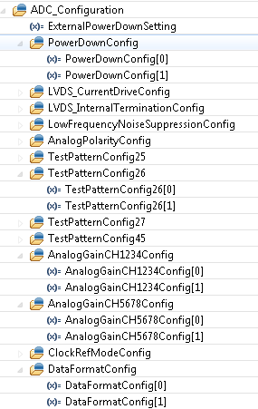
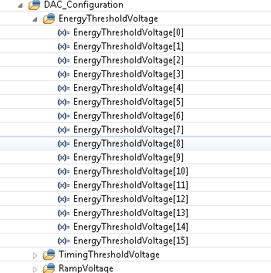
Hardware configuration descriptors
Descriptors for ADC and DAC in 16-ch detector boards
ADC descriptor
DAC descriptor

Slide 26
Mandatory and optional descriptors
 | Name | Description | Number
Mandatory descriptors | (1) Node | Node type, address, Integrity , firmware and software version | one per node
 | (2) Offspring | Offspring connection, enable/disable Status, node types and addresses | one per node
Optional descriptors | (3) Hardware | Descriptions of the hardware device (ADC, DAC, RAM, flash and etc. ) contained in the node. | one per device ( multiple per node)
 | (4)Application-specific | Application-specific descriptions (energy cut, time window and etc. usually associated to registers in FPGA firmware) | multiple per node
 | (5) User | User-definable information | multiple per node

Slide 27
Configuration data structure and configuration files
Configuration (text) file directly maps to data structure (profiles) in c programs. Data structure (profiles) in c programs directly maps to system hardware/firmware.
Host PC has the whole configuration settings (both configuration files in hard disk and configuration data structure in program). The configuration data structure defines:
(a) the profiles of all nodes and (b) the inter-connections between nodes
Each nodes have their own configuration settings (both configuration files in SD card and data structure in program) which are subsets of the whole configuration settings. The configuration data structure is identical to the profile data structure of each individual node.
Configuration files
Data structure in c program
configuration in system hardware
Data structure in host PC
Data structure in a node
Node profile

Slide 28
Configuration (text) file format
# System configuration descriptor. Information of the whole system structure (root
folder only!)
# A tree structure
# Node configuration descriptor. Information of current node, include:
# Node type and absolute address
# Firmware and software version information
# Integrity of this node
# Offspring descriptor Basic information of the offspring of current node, include:
# Offspring Connection Status
# Offspring Enable/disable Status
# Offspring’s node types and absolute addresses
# Hardware configuration descriptor 1 (hardware or application specific profiles).
…………………………………………………………………………
# Hardware configuration descriptor n (hardware or application specific profiles).
# User-defined descriptor 1
…………………………………………………………………………
# User-defined descriptor n

Slide 29
Summary: OpenPET system configurations
Configuration files in host PC (hard disk)
1. A tree folder structure with one folder per node
2. In each folder, there are:
(1) Firmware and software (binary) for this node.
(2) A configuration (text) file describe the profile of the node, which contains:
(a) A node descriptor. Information of current node, include:
(i) Node type and absolute address
(ii) Firmware and software version information
(iii) Integrity of this node
(b) A offspring descriptor. Basic information of the offspring of current node, include:
(i) Offspring Connection Status
(ii) Offspring Enable/disable Status
(iii) Offspring’s node types and absolute addresses
(c) Some hardware descriptors (hardware or application specific descriptors).
(d) Some user-defined descriptors
(3) Memory mapping files (if applicable).
(4) A system description file which has information of the whole system structure, will be generated and placed in the root folder. The main purpose of this file is to make it more convenient for the user to understand the tree structure of the system.
Please refer to chapter 1.4!

Slide 30
Summary: OpenPET system configurations
Configuration files in each node (SD card)
(1) Firmware and software (binary) for this node.
(2) A configuration (text) file describe the profile of this node, which contains:
(a) A node descriptor. Information of current node, include:
(i) Node type and absolute address
(ii) Firmware and software version information
(iii) Integrity of this node
(b) A offspring descriptor. Basic information of the offspring of current node, include:
(i) Offspring Connection Status
(ii) Offspring Enable/disable Status
(iii) Offspring’s node types and absolute addresses
(c) A system descriptor. Information of the whole system structure (root
folder only!)
(d) Some hardware descriptors (hardware or application specific descriptors).
(e) Some user-defined descriptors
(3) Memory mapping files (if applicable)
Please refer to chapter 1.4!

Slide 31
Siemens system addressing: start from a pre-determined tree topology
Host PC
Coincidence controller
PC-104
FPGA
DEA0~11
DEA0~11
DEA0~11
Controller interface
Controller interface
Controller interface
FPGA
FPGA
FPGA
AS0~7
AS0~7
AS0~7
FPGA
FPGA
FPGA

Slide 32
System booting-up and addressing (start from an unknown tree topology )

Slide 33
Command script mode
1. Automatic mode, do not need too much interferences from users.
2. Top level control console (GUI or command scripts).
3. Results are in analysis report files.
Acceptable range setting file
System calibration and characterization
CMD scripts
System calibration
System HW/FW
System config. files
System configuration & test CMD scripts
DAQ configuration and DAQ
CMD scripts
List mode data (with a head file)
Data analysis CMD scripts
analysis result report files
System configuration & basic test
Data acquisition
Data analysis and visualization

Slide 34
GUI mode
Acceptable range setting file
Acceptable range setting GUI
System calibration and characterization
CMD scripts
System calibration
System HW/FW
System config. files
System configuration & test CMD scripts
DAQ configuration and DAQ
CMD scripts
List mode data (with a head file)
Data analysis CMD scripts
analysis result report files
System configuration and test GUI
DAQ configuration GUI and DAQ GUI
Data analysis & visualization GUI
System configuration & basic test
Data acquisition
Data analysis and visualization

Slide 35
File formats
System Configuration files
in host PC
In each node
Data files
List mode data file
Head file
Analysis result report files
Range setting file

Slide 36
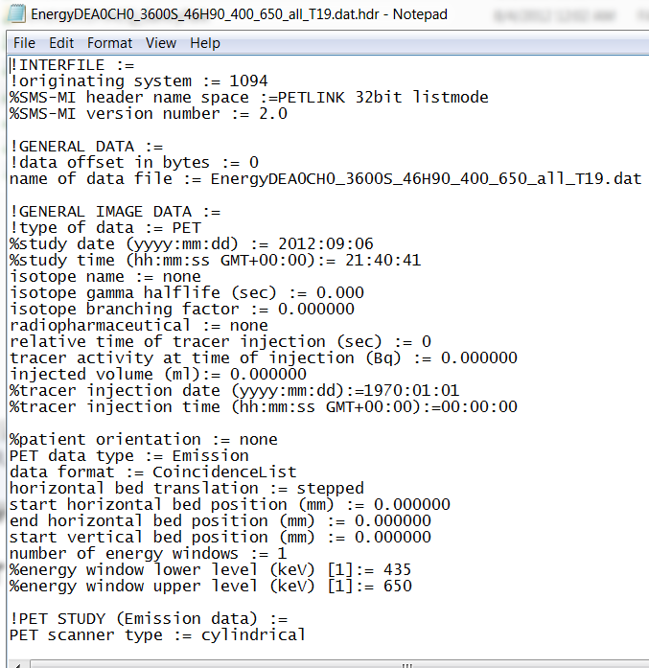
Head file format
File name
Date and time
Data type
Data collection time
Software version
Firmware version
User defined comments
Siemens

Slide 37
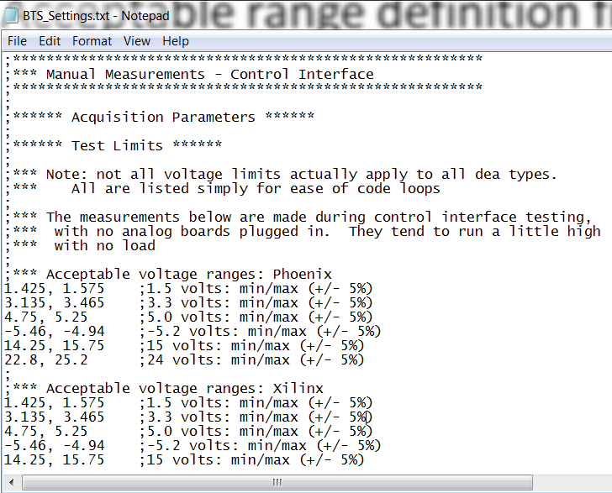
Acceptable range setting file?

Slide 38
Analysis result report files
1. A file structure similar to the one used in system configuration files (host PC part)
2. A summary file
Root folder: provide information of the whole system structure and the summary of the data analysis results. The main purpose of this file is to make it more convenient for the user to understand the tree structure of the system.
Each folder: A summary of the results
3. The data analysis result files at the bottom of the REPORT tree must contain only numeric data.
https://github.com/openpet-developer/HostPC/tree/master/GUI/Example%20file%20structure

Slide 39
List Mode Binary Data Format

Slide 40
Event words and status words
In general, there are two kinds of words in the OpenPET list mode data:
Event words, include
-- Single event words, and
-- Coincidence
Status words transmit information other than the event data to the host PC, such as:
-- Event data format
-- Time information
-- Single or coincidence event rate
-- System configuration and status
-- Application-specific information such as patient bed position, transmission source position, system temperature, ECG signal, gate signal and etc.

Slide 41
Event words
Event word path
Add 3-bit MB address to single event data.
Generate coincidence event data (optional).
Insert status words to the data stream.
Generate original single event data
Add 3-bit DB
address to the
single event data
Add 3-bit DUC
address to the
single event data
Host PC
DB
DUC
MB
CUC
Add 3-bit DB address to single event data.
Generate coincidence event data (optional).
Insert status words to the data stream.
Generate original single event data
Host PC
DB
CDUC
Add 3-bit DUC address to single event data.
Generate coincidence event data (optional).
Insert status words to the data stream.
Generate original single event data
Add 3-bit DB
address to the
single event data
Host PC
DB
DUC
CUC

Slide 42
Event data length
Data from DB→DUC, DUC→ MB and MB→CUC
Single event data only
32-bit mode or 64-bit mode.
Data from CUC → host PC
Single event data, coincidence event data and status words.
32-bit mode, 64-bit mode, and 128-bit mode.

Slide 43
Data paths and data mode combinations
32 bits
32 bits
32 bits
32 bits
DB
DUC
MB
CUC
Host PC
8 system clocks
32 bits
32 bits
32 bits
64 bits
DB
DUC
MB
CUC
Host PC
64 bits
64 bits
64 bits
64 bits
DB
DUC
MB
CUC
Host PC
16 system clocks
64 bits
64 bits
64 bits
128bits
DB
DUC
MB
CUC
Host PC
Oscilloscope mode

Slide 44
DB→DUC, DUC→ MB and MB→CUC
32-bit data (8 system clocks)
General definition
1
MB address
DUC address
DB address
Block address
Crystal ID
31
30
29
28
27
26
25
24
23
22
21
20
19
18
17
16
Crystal ID
Payload
15
14
13
12
11
10
9
8
7
6
5
4
3
2
1
0

Slide 45
DB→DUC, DUC→ MB and MB→CUC
32-bit mode (8 system clocks)
Payload definition
-- Time mode – Bit 10~0, TDC data bits (11 bits, LSB: 50ps).
-- Energy mode – Bit 10~0, energy data bits (11 bits).
-- Test mode1 – Bit 10~0, test pattern data: 10101010101.
-- Test mode2 – Bit 10~0, test pattern data: 01010101010.
-- Anger-logic flood map plot mode – Bit 18, not used,
Bit 17~9, Y value (9 bits), Bit 8~0, X value (9 bits).
-- User-defined mode 1 - 11 bits of payload
-- User-defined mode 2 - 14 bits of payload
-- User-defined mode 3 - 17 bits of payload
-- User-defined mode 4 - 22 bits of payload
-- User-defined mode 5 - 25 bits of payload
-- User-defined mode 6 - 28 bits of payload
Standard
User-defined

Slide 46
DB→DUC, DUC→ MB and MB→CUC
32-bit mode (Oscilloscope mode)
General definition
1
MB address
DUC address
DB address
Channel address
Unused
31
30
29
28
27
26
25
24
23
22
21
20
19
18
17
16
Data counter
Raw ADC data
15
14
13
12
11
10
9
8
7
6
5
4
3
2
1
0
The maximum length of the raw data train is 64

Slide 47
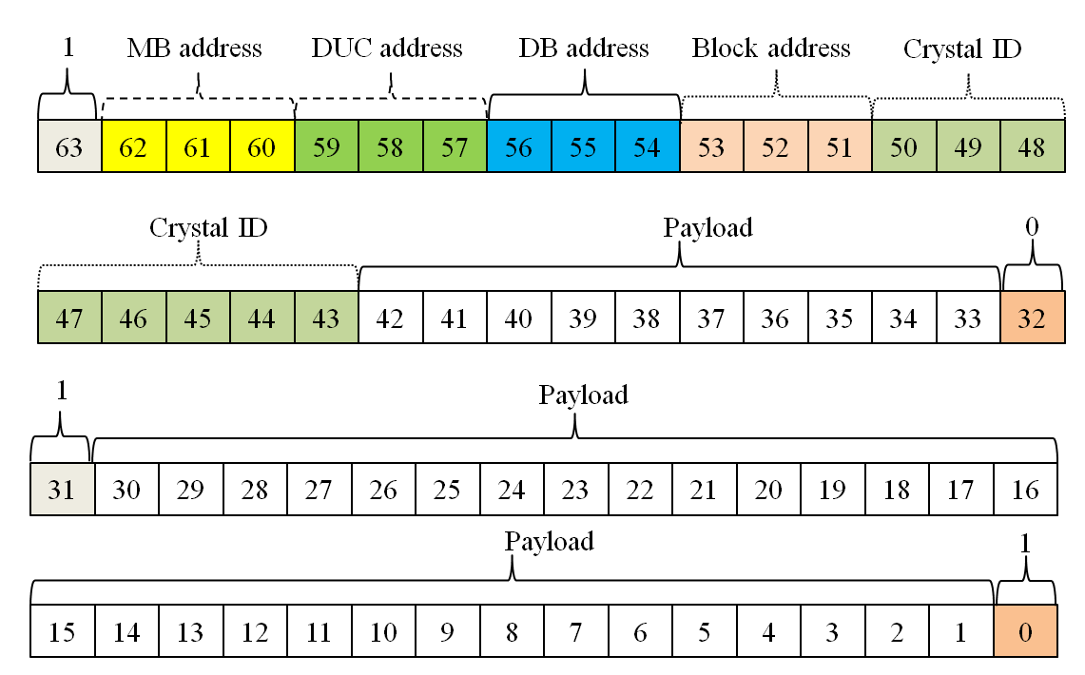
DB→DUC, DUC→ MB and MB→CUC
64-bit data (16 system clocks)
General definition

Slide 48
DB→DUC, DUC→ MB and MB→CUC
32-bit mode (8 system clocks)
Payload definition
-- Time mode – Bit 10~0, TDC data bits (11 bits, LSB: 50ps).
-- Energy mode – Bit 10~0, energy data bits (11 bits).
-- Test mode1 – Bit 10~0, test pattern data: 10101010101.
-- Test mode2 – Bit 10~0, test pattern data: 01010101010.
-- Anger-logic flood map plot mode – Bit 18, not used,
Bit 17~9, Y value (9 bits), Bit 8~0, X value (9 bits).
-- User-defined mode 1 - 11 bits of payload
-- User-defined mode 2 - 14 bits of payload
-- User-defined mode 3 - 17 bits of payload
-- User-defined mode 4 - 22 bits of payload
-- User-defined mode 5 - 25 bits of payload
-- User-defined mode 6 - 28 bits of payload
Standard
User-defined

Slide 49
CUC → host PC
Single event mode
In single event data mode (including the 32-bit raw ADC data mode), the formats of the data from CUC/CDUC→ host PC are the exactly the same that those defined in previous section (DB→DUC, DUC→ MB and MB→CUC).

Slide 50
CUC → host PC
Coincidence event mode
Two 32-bit single event data → one 64-bit coincidence event data
Two 64-bit single event data → one 128-bit coincidence event data
Two 32-bit single event data → one 32-bit coincidence event data
Two 64-bit single event data → one 64-bit coincidence event data
1
MB address
DUC address
DB address
Block address
Crystal ID
63
62
61
60
59
58
57
56
55
54
53
52
51
50
49
48
Single Event 1
Crystal ID
Payload
47
46
45
44
43
42
41
40
39
38
37
36
35
34
33
32
Valid
MB address
DUC address
DB address
Block address
Crystal ID
31
30
29
28
27
26
25
24
23
22
21
20
19
18
17
16
Single Event 2
Crystal ID
Payload
15
14
13
12
11
10
9
8
7
6
5
4
3
2
1
0

Slide 51
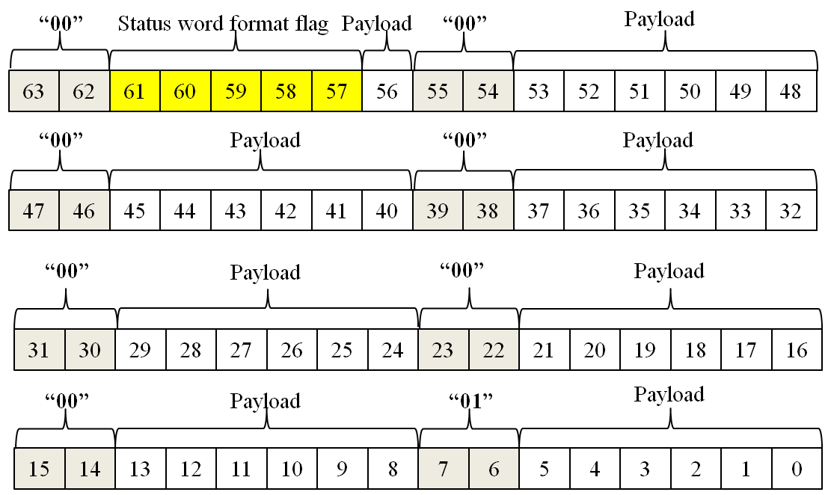
Status word (fixed to 64 bits)
General definition

Slide 52
Decoding List Mode Binary Data

Slide 53
Data In
Status word
Event word
Single Event
Coincidence event
Raw ADC
32-bit
64-bit
32:32
32:64
64:64
64:128
Event data format / Timer
Single event rate
Coincidence event rate

Slide 54
Algorithm to decode list mode data file
Start
Read 8 bytes of data
Check the two MSB of the 8 bytes of data
Find pattern “00”, …, “01”?
No
Yes
No
An event format status word (00000)?
Yes
Determine the event data format
End

Slide 55
Status Words
Provide ancillary information
Format
64 bits marked by “00” beginning each byte
Last byte begins “01”
Format flag indicates type of word
Payload contains data
64-bit status word

Slide 56
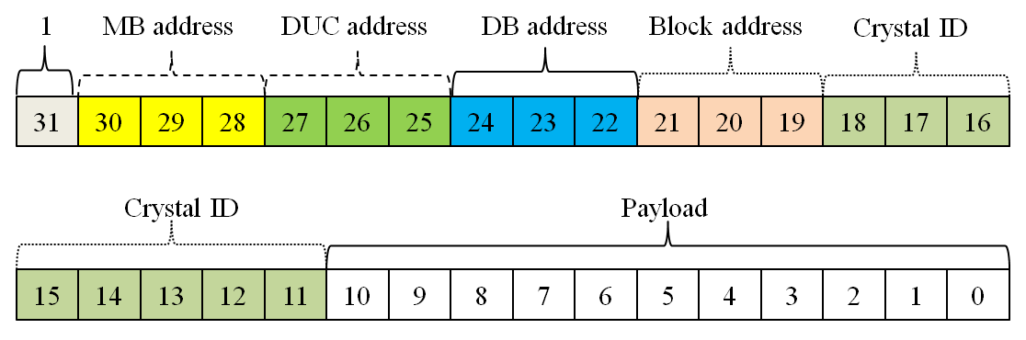
Event Words
Raw ADC
32 bits
Single event
32 or 64 bits
Coincidence event
32, 64, or 128 bits
Format
Most-significant bit always “1”
Ex. 32-bit single event word

Slide 57
Data In
Status word
Event word
Single Event
Coincidence event
Raw ADC
32-bit
64-bit
32:32
32:64
64:64
64:128
Event data format / Timer
Single event rate
Coincidence event rate

Slide 58
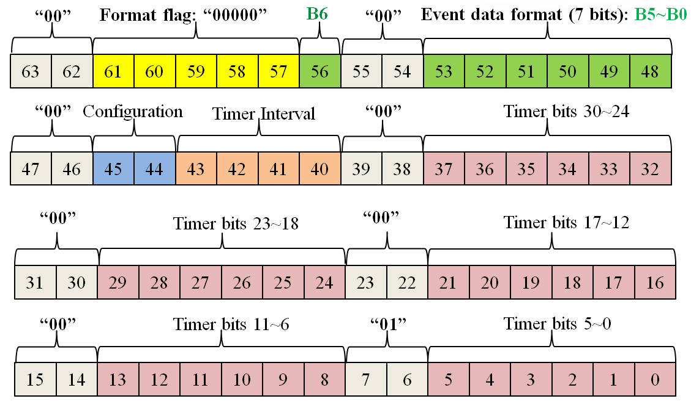
Status Word – Event data format / Timer
Bit 63-62, 55-55, 47-46, 39-38, 31-30, 23-22, 15-14: “00”
Bits 7-6: “01”
Bit 61-57: status word type – format/timer word = “00000”
Bit 56: single or coincidence
Bits 53-48: event word type (i.e. raw ADC)
Bits 45-44: system config (i.e. small config)
Bits 43-40: status word frequency (i.e. every 1 ms)
Remaining 30 bits: timer
Event data format / Timer word

Slide 59
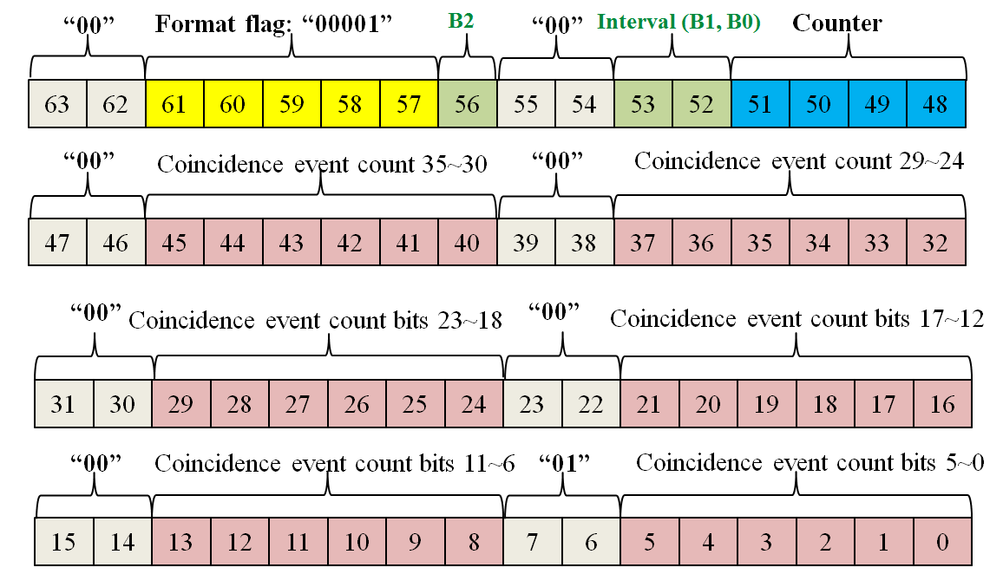
Status Word – Coincidence event rate
Bit 63-62, 55-55, 47-46, 39-38, 31-30, 23-22, 15-14: “00”
Bits 7-6: “01”
Bit 61-57: status word type – coincidence rate word = “00001”
Bit 56,53,52: status word frequency (i.e. every 1 sec)
Bits 51-48: coincidence event rate status word counter
Remaining 36 bits: coincidence event counter
Coincidence event rate word

Slide 60
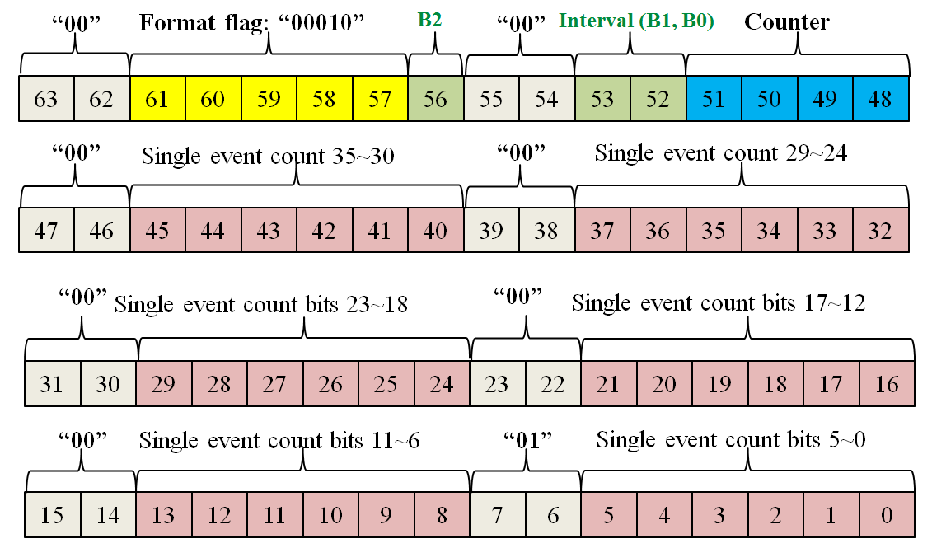
Status Word – Single event rate
Bit 63-62, 55-55, 47-46, 39-38, 31-30, 23-22, 15-14: “00”
Bits 7-6: “01”
Bit 61-57: status word type – single event rate word = “00010”
Bit 56,53,52: status word frequency (i.e. every 1 sec)
Bits 51-48: single event rate status word counter
Remaining 36 bits: single event counter
Single event rate word

Slide 61
Data In
Status word
Event word
Single Event
Coincidence event
Raw ADC
32-bit
64-bit
32:32
32:64
64:64
64:128
Event data format / Timer
Single event rate
Coincidence event rate

Slide 62
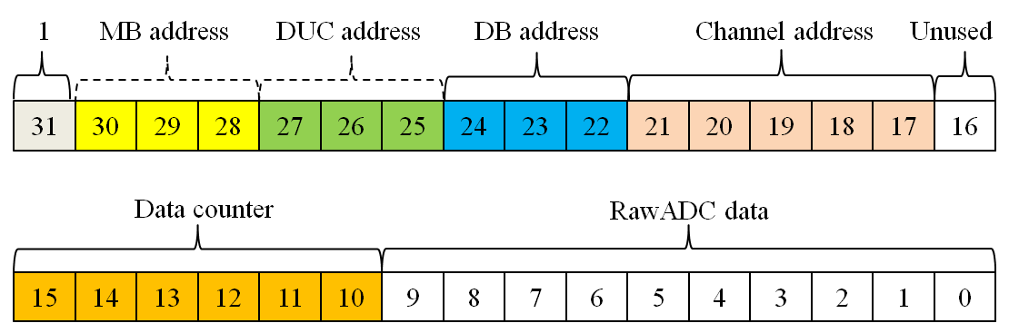
Single Event - Raw ADC
Bit 31: “1”
Bits 30-17: address
Bit 16: unused
Bits 15-10: 64-level counter to create ADC train
Bits 9-0: raw ADC data
32-bit raw ADC data

Slide 63
Single Event – 32-bit data
Bit 31: “1”
Bits 30-11: address
Bits 10-0: payload data
Time mode, energy mode, test mode, flood map mode, user-defined mode
32-bit single event data

Slide 64
Single Event – 64-bit data (not recommended)
Bit 63: “1”
Bit 32: “0”
Bit 31: “1”
Bit 0: “1”
Bits 62-43: address
Bits 42-33,30-1: payload data
64-bit single event data

Slide 65
Data In
Status word
Event word
Single Event
Coincidence event
Raw ADC
32-bit
64-bit
32:32
32:64
64:64
64:128
Event data format / Timer
Single event rate
Coincidence event rate

Slide 66
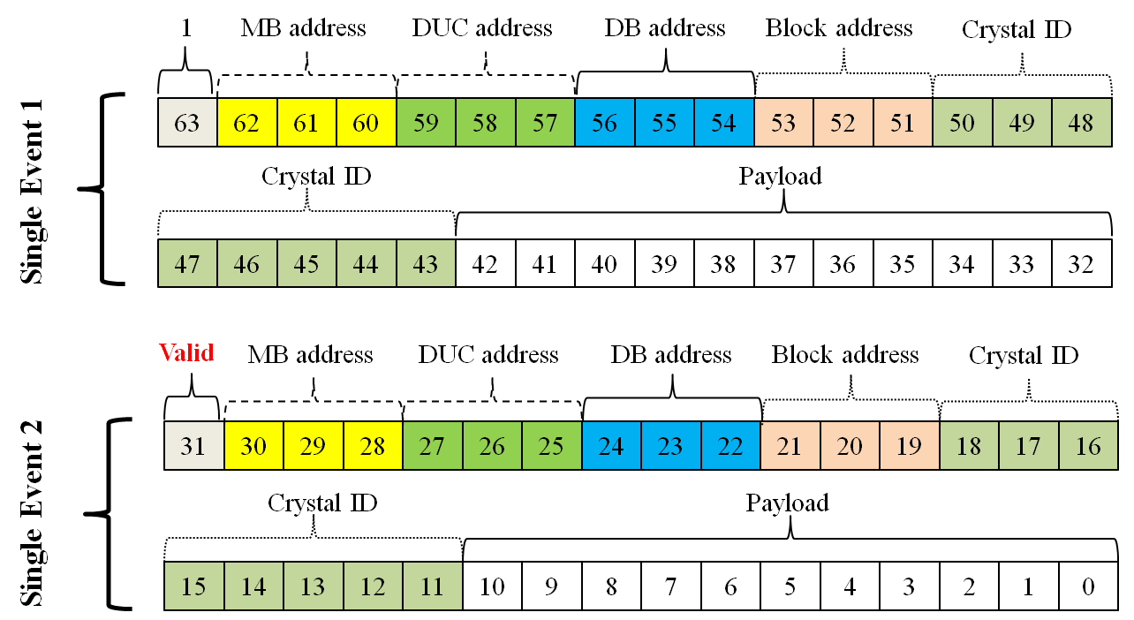
Coincidence event – 32-bit → 64-bit
Two 32-bit single event words
Bit 31: set to 1 if valid coincidence data; 0 if not
32→64-bit coincidence event data

Slide 67
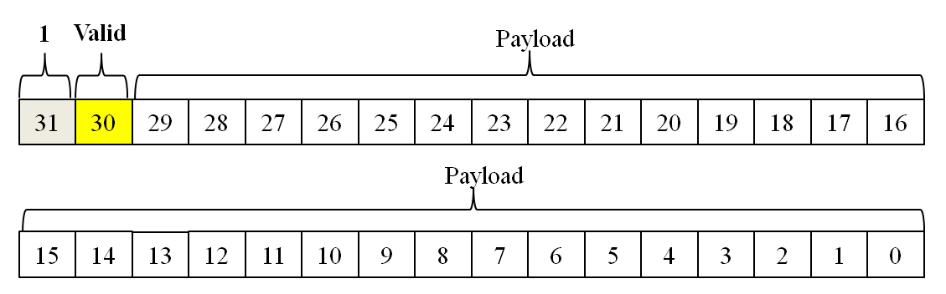
Coincidence event – 32-bit → 32-bit
Bit 31: “1”
Bit 30: set to 1 if valid coincidence data; 0 if not
Bits 29-0: determined by user (i.e. coincidence pair ID and time differential)
32→32-bit coincidence event data

Slide 68
Coincidence event – 64-bit → 128-bit
Two 64-bit single event words
Bit 63: set to 1 if valid coincidence data; 0 if not
64-bit single event data

Slide 69
Coincidence event – 64-bit → 64-bit
Bit 63: “1”
Bit 62: set to 1 if valid coincidence data; 0 if not
Bits 61-0: determined by user (i.e. coincidence pair ID and time differential)

Slide 70
Data In
Status word
Event word
Single Event
Coincidence event
Raw ADC
32-bit
64-bit
32:32
32:64
64:64
64:128
Event data format / Timer
Single event rate
Coincidence event rate

Slide 72
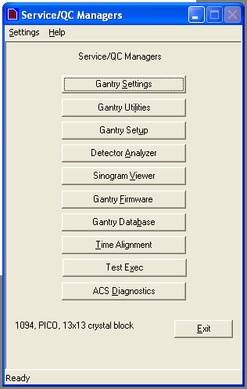
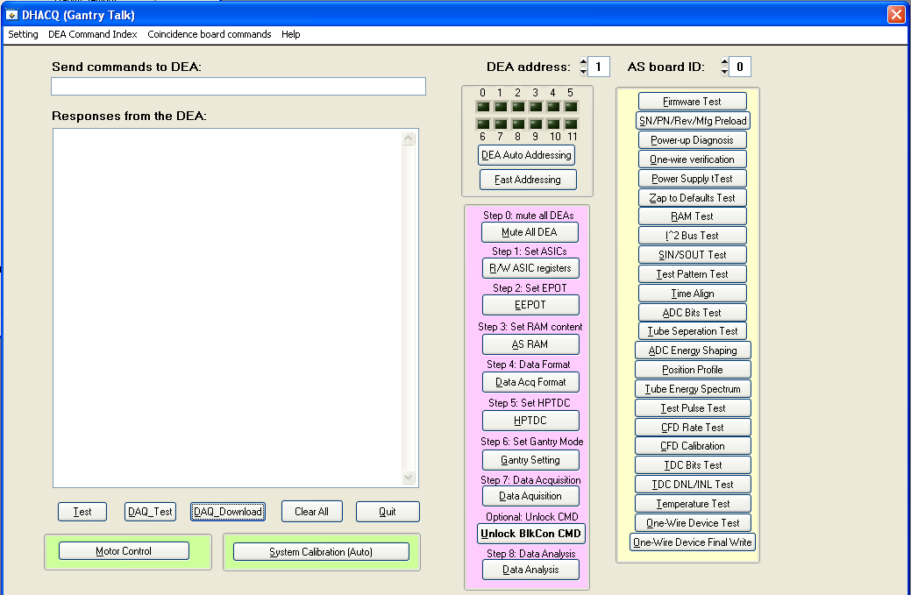
Graphical User Interface (GUI) design
Top level design

Slide 73
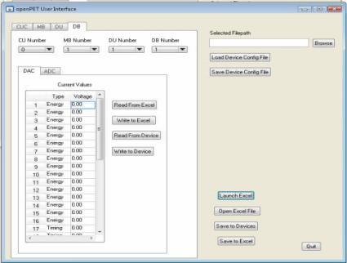
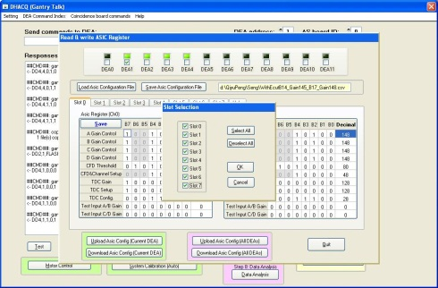
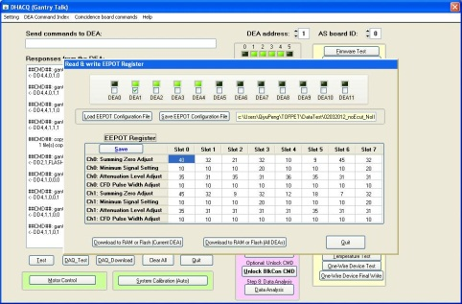
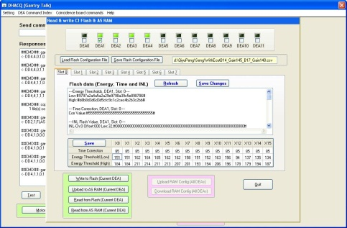
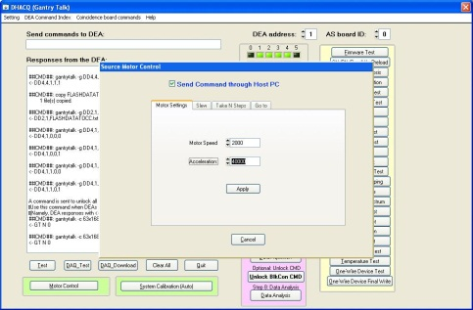
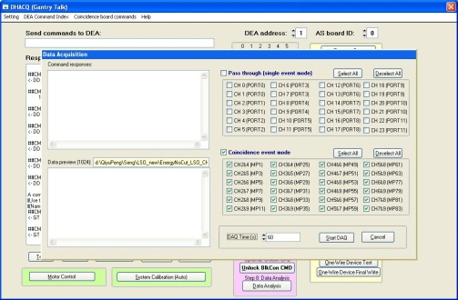
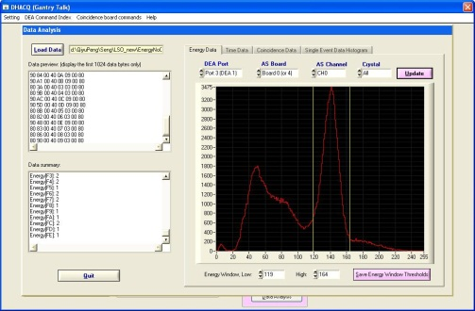
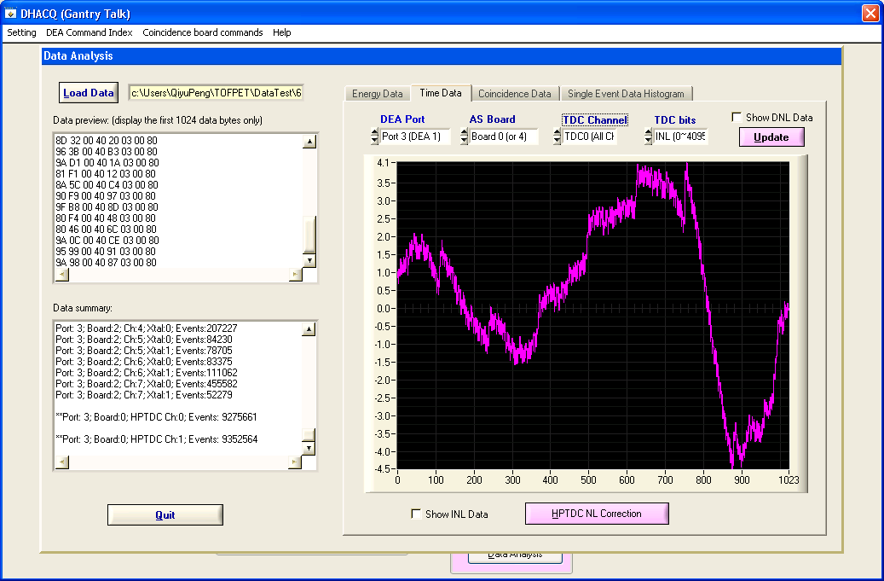
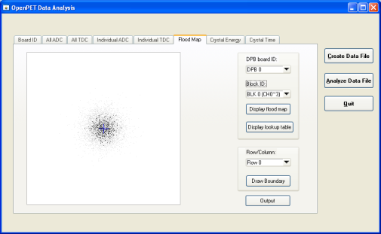
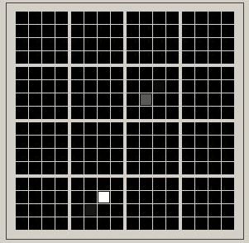
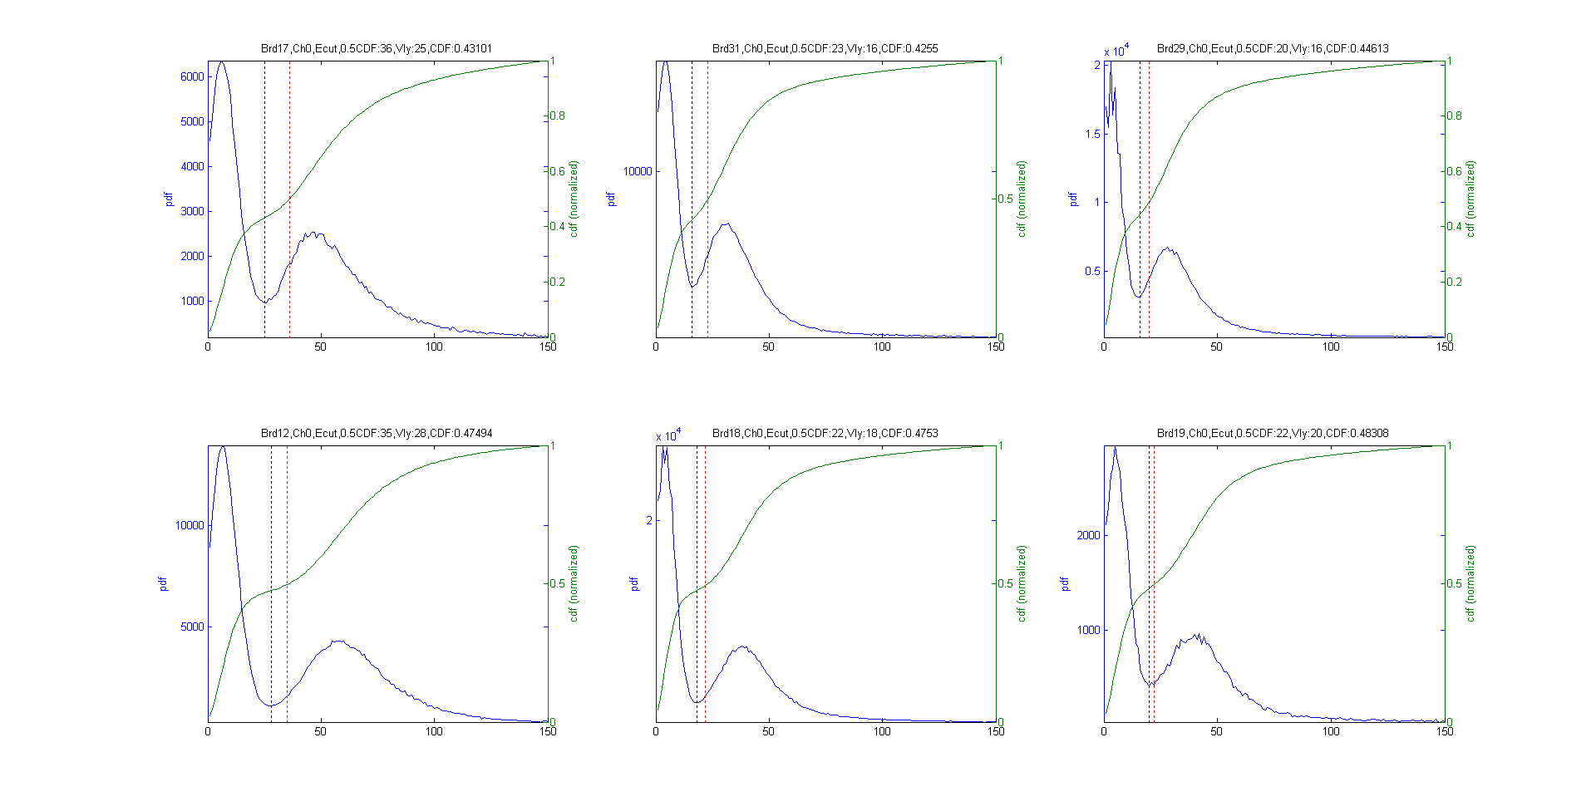
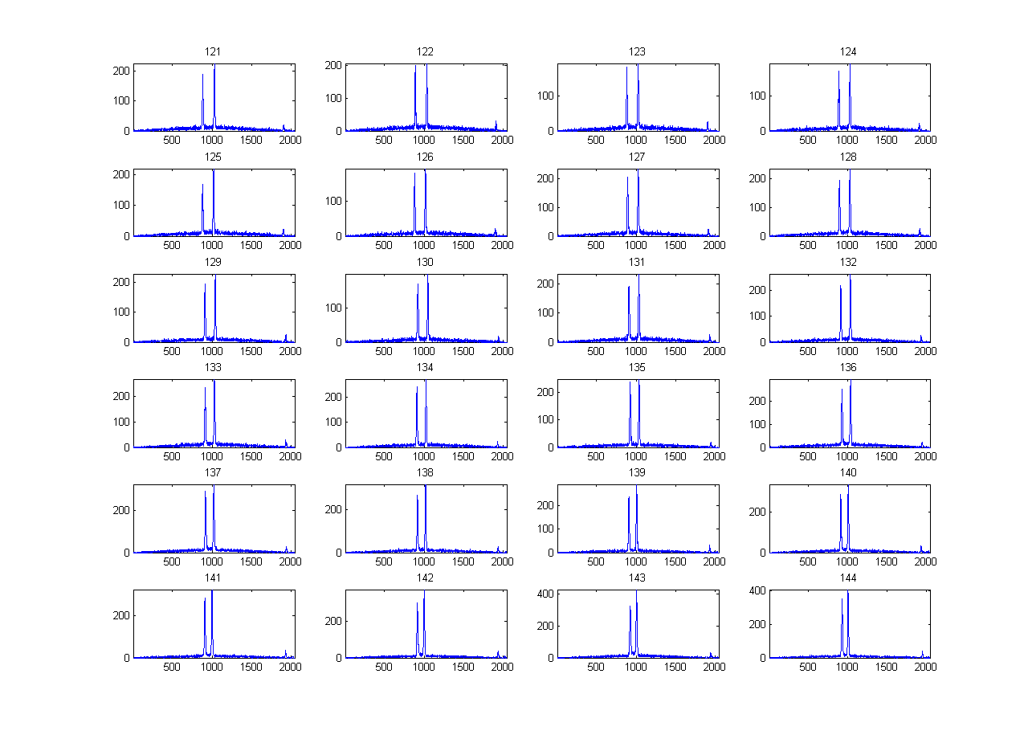
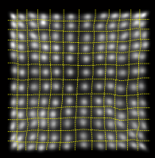
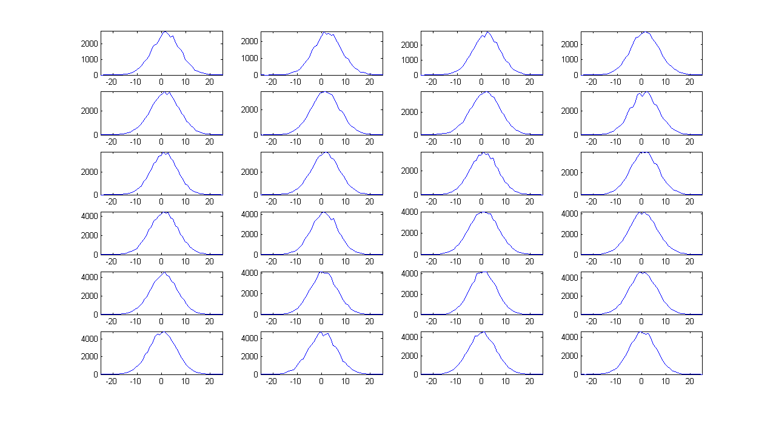

Graphical User Interface (GUI) design
System configuration database management
Analog gain settings
CFD settings
Energy window settings
Serial communication
Data acquisition
Energy data analysis
TDC calibration
Chinh Vu and Michael Malus also contributed to the GUI design
Crystal decoding
Delay compensation
Time analysis
Sinogram analysis
Flood map display
(for block detector)
Data analysis SW package
(currently in Matlab)
SSPM event display

Slide 74
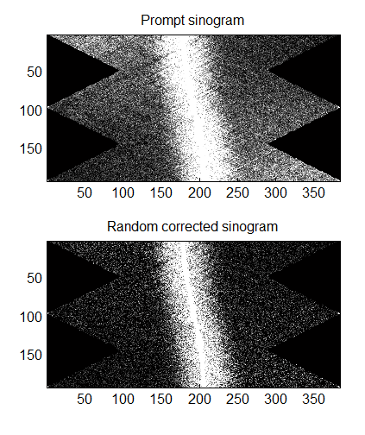
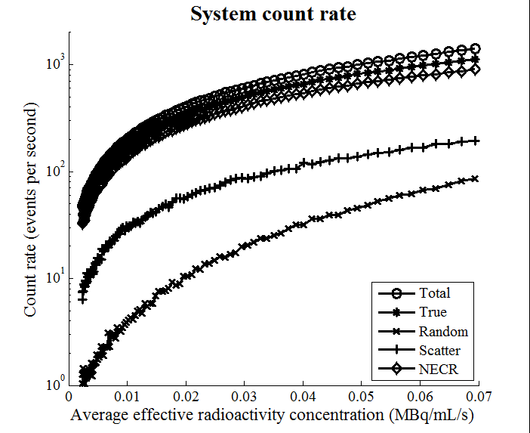
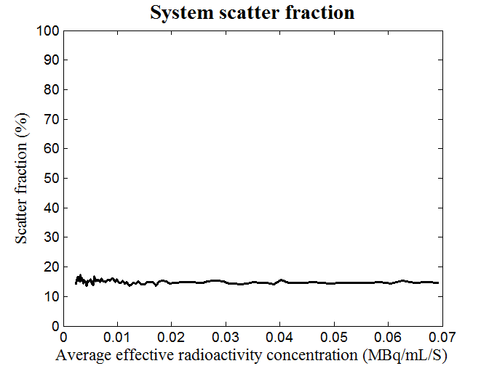
Graphical User Interface (GUI) design
System characterization

